Slide 1
BFX-AT100 (T99X171.00)
USB Not Recognize Failure Report
Prepared by: PE – Nguyen Nhat Nam
Reviewed by: Michael
Date: May 25th 2022

Slide 2
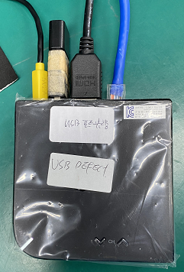
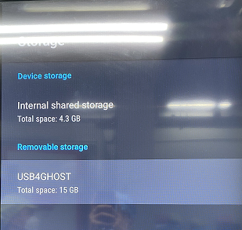
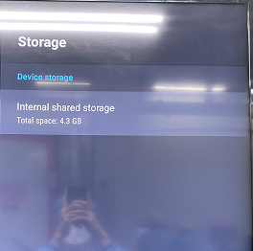
Description of Problems
Issue Description
ALT customer brought 1pcs USB did not recognize (SN of NG product: 38D57AD806A5) to Vietnam for further analyzing on 05.04.2022..
USB plugged in product
USB recognized
USB not recognized

Slide 3
Containment
Recheck OBA, Take X-ray and VI PCBA
OBA environment verification → USB did not recognized
Open housing checking.
Baking PCBA with 70ºC in 2 days.
Recheck OBA environment verification → USB did not recognized → OBA can cover 100% this issue.
Take X-ray and VI PCBA → Did not find out any abnormal.

Slide 4
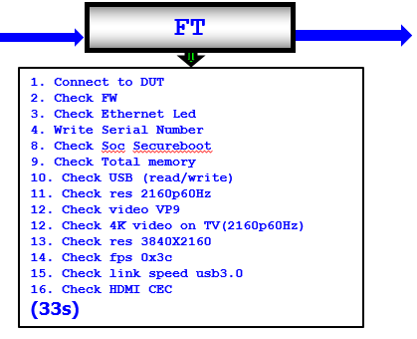

Failure Analysis – 1
1. Check Customer feedback unit production test log.
- Check SFIS data record test log is normal, USB function working normal ( USB function test at FT station ).
Log test USB Pass
Summary:
- Didn’t find out any abnormal related to USB function.

Slide 5
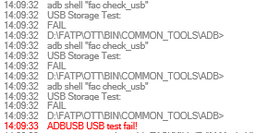

Failure Analysis – 2
2. Retest USB didn’t recognize unit at FT station
Retest USB didn’t recognize on all test machines at FT station:
Test Machine Name | Result
L10T99FT001 | Fail
L10T99FT002 | Fail
L10T99FT003 | Fail
L10T99FT004 | Fail
USB test Fail
USB test Pass
Summary: .
- Test program can cover this issue 100% at FT station.

Slide 6
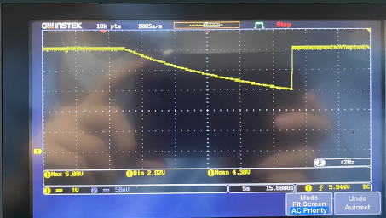
Failure Analysis – 3
3. Measure Power Supply
Measure power supply of USB block of NG sample and OK sample, result as below:
- Power supply of USB block has abnormal
Voltage measurement
Location | Voltage power spec(±5% VCC) | Ok sample | NG sample
L301 (VDDCPU - 0.8V) | (0.76-0.84)V | Pass | Pass
L302 (VDD_EE - 0.8V) | (0.76-0.84)V | Pass | Pass
L303 (P1V2 - 1.2V) | (1.14-1.26)V | Pass | Pass
L304 (P3V3 - 3.3V) | (3.135-3.465)V | Pass | Pass
R324 (P1V8 - 1.8V) | (1.71-1.89)V | Pass | Pass
R325 (P2V5 - 2.5V) | (2.375-2.625)V | Pass | Pass
C908 (USB_5V) | (4.75-5.25)V | Pass | Fail
Power supply of USB abnormal
Summary: Check power supply of USB block (U902) found out the output voltage gradually decreases and then increases again (from 5V decrease to 3,1V and increases 5V again).

Slide 7
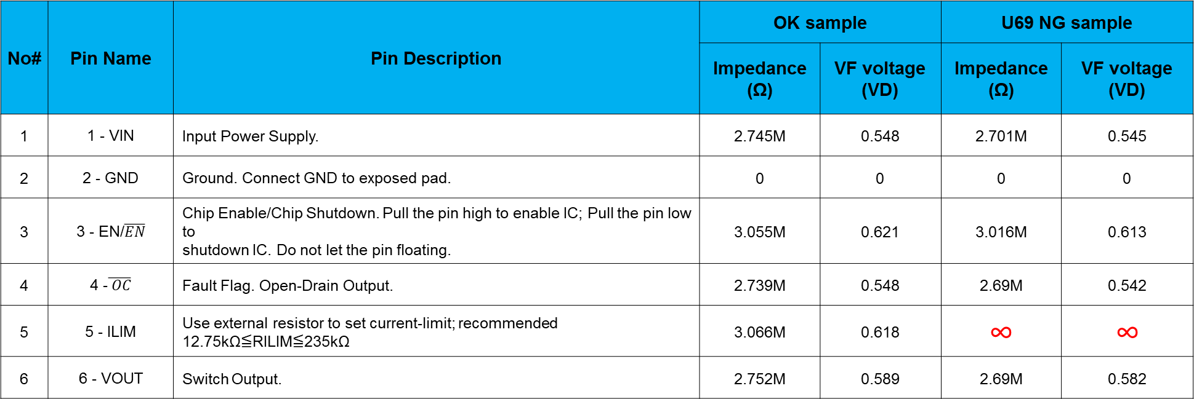
Failure Analysis – 4
4. Measure Impedance & Voltage Diode of U902
Remove then measure impedance & voltage diode of U902 of NG sample and OK sample, result as table below:
No# | Pin Name | Pin Description | OK sample |  | U69 NG sample
 |  |  | Impedance (Ω) | VF voltage (VD) | Impedance (Ω) | VF voltage (VD)
1 | 1 - VIN | Input Power Supply. | 2.745M | 0.548 | 2.701M | 0.545
2 | 2 - GND | Ground. Connect GND to exposed pad. | 0 | 0 | 0 | 0
3 | 3 - EN/$\overline{EN}$ | Chip Enable/Chip Shutdown. Pull the pin high to enable IC; Pull the pin low to shutdown IC. Do not let the pin floating. | 3.055M | 0.621 | 3.016M | 0.613
4 | 4 -$\overline{ OC}$ | Fault Flag. Open-Drain Output. | 2.739M | 0.548 | 2.69M | 0.542
5 | 5 - ILIM | Use external resistor to set current-limit; recommended 12.75kΩ≦RILIM≦235kΩ | 3.066M | 0.618 | ∞ | ∞
6 | 6 - VOUT | Switch Output. | 2.752M | 0.589 | 2.69M | 0.582
Summary: Impedance & voltage diode measure U902 of USB block found out abnormal at pin 5 – ILIM.

Slide 8
Failure Analysis – 5
5. Swap power supply IC (U902) of USB block
U902 swap verification
- Swap verification between NG U902 and OK U902, result as table below:
USB did not recognize | 1 | 2 | 3 | 4 | 5
OK board + OK U902 | OK | OK | OK | OK | OK
NG board + NG U902 | NG | NG | NG | NG | NG
OK board + NG U902 | NG | NG | NG | NG | NG
NG broad + OK U902 | OK | OK | OK | OK | OK
- Measure output voltage of U902 (C908) → Voltage stable ~ 5V
Summary:
- Measure output voltage of U902 (C908) → Voltage stable ~ 5V
→ As analysis above this issue follow U902 ( P/N: 033.00336.005 ) component (Vendor: FITI – Date code: 2139).

Slide 9
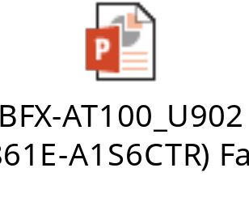
Conclusion
As analysis above this issue follow U902 ( P/N: 033.00336.005 ) component (Vendor: FITI – Date code: 2139).
Send NG material and report to SQE: Mr. Ha. Done: 05/23/2022.
Need SQE send NG component to FITI vendor for further analysis. Due date: 06/01. Owner: SQE: Mr. Ha
See an attachment below.

